Slide 1
Addition of a non-immersive virtual reality component to treadmill training to reduce fall risk in older adults (V-TIME): a randomised controlled trial
The Lancet 2016

Slide 2
Introduction
1. About 30% of community-dwelling adults older than 65 years fall at least once per year.
2. Among people with mild cognitive impairment, dementia (痴呆), or Parkinson’s disease, falls are even more common with 60–80% of individuals reporting falls each year.
3. Previous multifactorial interventions have generally focused on individual risk factors separately, largely ignoring their interdependence. Cognition and motor aspects might both be targeted, but usually only individually.
4. A multimodal treadmill training programme augmented with a computer-simulated non-immersive virtual reality (VR) could improve both motor and cognitive aspects of fall risk.

Slide 3
Introduction
5. We aimed to test the hypothesis that a 6 week programme of treadmill training combined with a VR component would lead to a lower incidence of falls than would a similar intensity intervention delivered via treadmill training alone.

Slide 4
Methods
1. Study design and participants
(1) We conducted a prospective, single-blind, randomised controlled trial, with 6 months follow-up, at five clinical centres across five countries (Belgium, Israel, Italy, the Netherlands, and the UK).
(2) Participants
(a) Inclusion criteria:
Aged 60−90 years
Able to walk for at least 5 min unassisted
People who self-reported two or more falls within 6 months before screening
People with mild cognitive impairment (if they had a score of 0.5 on the Clinical Dementia Rating scale)
People with Parkinson’s disease were included if they had been diagnosed in accordance with the UK Brain Bank criteria

Slide 5
Methods
1. Study design and participants
(2) Participants
(b) Exclusion criteria:
Psychiatric (精神病) comorbidity
History of stroke, traumatic brain injury, or other neurological disorders
Acute lower back or lower extremity pain
Peripheral neuropathy (周围神经病变)
Rheumatic (风湿病) and orthopaedic (矫形的) diseases
A clinical diagnosis of dementia or severe cognitive impairment (MMSE score<21)

Slide 6
Methods
1. Study design and participants
(3) Randomisation and masking
(a) Participants were randomly assigned to receive either treadmill training plus VR or treadmill training alone.
(b) Random assignment to training arm was stratified by subgroups of patients
Older adults with a history of falls
Individuals with mild cognitive impairment
People with Parkinson’s disease
Male and female
(c) Allocation was done by the study contract research organisation (Advanced Drug and Device Services, Brno, Czech Republic).

Slide 7
Methods
1. Study design and participants
(4) Procedures
(a) Participants aimed to train three times per week for 6 weeks in both groups, with each session lasting about 45 min.
(b) Treadmill training plus VR intervention
Kinect, large screen, treadmill
Real-life challenges, consisting of obstacles, multiple pathways, and distractors that necessitated continual adjustment of steps.
Progression of the intervention was modulated via the speed of the treadmill, the duration of the walking bouts within a given training session, and the size and frequency of the virtual obstacles and the distractors.

Slide 8
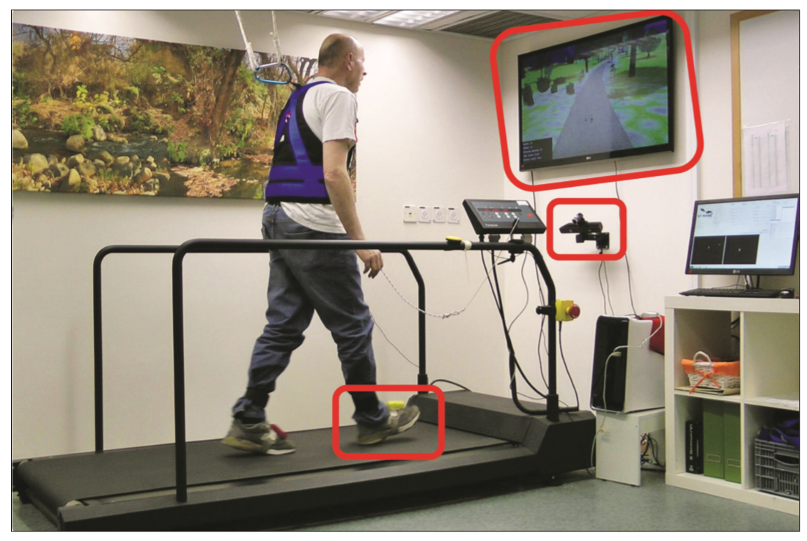

Slide 9
Methods
1. Study design and participants
(4) Procedures
(c) Treadmill training
Training progression was based on individual performance by increasing the duration of walking and walking speed in a standardised, prespeciﬁed fashion.

Slide 10
Methods
2. Outcomes
(1) The incident rate of falls (an unexpected event in which the participant comes to rest on the ground, floor or lower level) in the 6 months (182 days) after the end of training.
(2) Gait speed and gait variability (using a Zeno instrumented walkway and PKMAS software, Havertown, PA, USA)
(3) Inertial measurement units placed on both ankles and the lower back (Opal, APDM, Portland, OR, USA) were used to quantify foot clearance (足间隙) during obstacle negotiation.
(4) Endurance was assessed with the 2 min walk test.
(5) The Short Physical Performance Battery (SPPB) was used to assess balance and mobility.
(6) Physical Activity Scale for the Elderly questionnaire was used to assess everyday activity.
(7) Attention and executive function were assessed by use of a computerised neuropsychological test battery (NeuroTrax Corp, Medina, Modiin, Israel).
(8) Health related quality of life was measured with the SF-36 Health Survey.
(9) Disease severity in the patients with Parkinson’s disease was classified in accordance with the motor part of the Uniﬁ ed Parkinson’s Disease Rating Scale (UPDRS-III)

Slide 11
Results
1. 16 (5%) participants dropped out before starting training, and 4(1%) participants did not complete the minimum training sessions needed, leaving 282 participants.
2. The distribution of the subgroups was similar between the two groups (146 vs 136):
(1) Parkinson’s disease (66 vs 64)
(2) Mild cognitive (23 vs 20)
(3) People with idiopathic falls (57 vs 52)
3. In the treadmill training plus VR group, the post-training incident rate was 6.00 falls per 6 months. In the treadmill training group, the incident rate decreased to 8.27 falls per 6 months but this reduction was not significant compared with the 6 months before training.

Slide 12
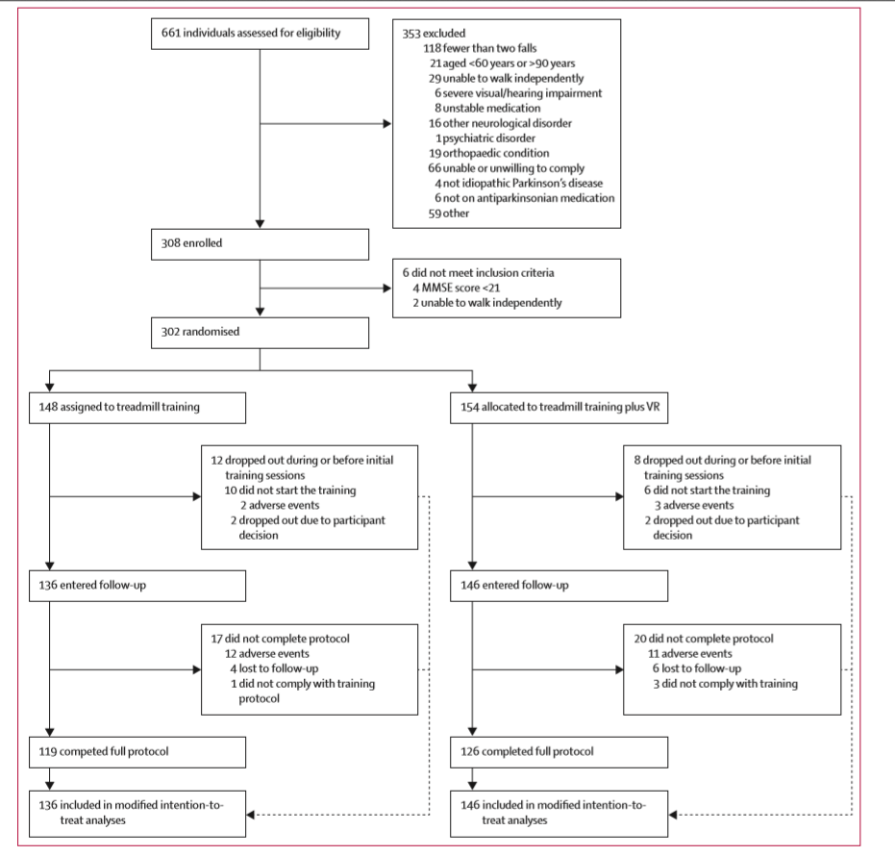

Slide 13
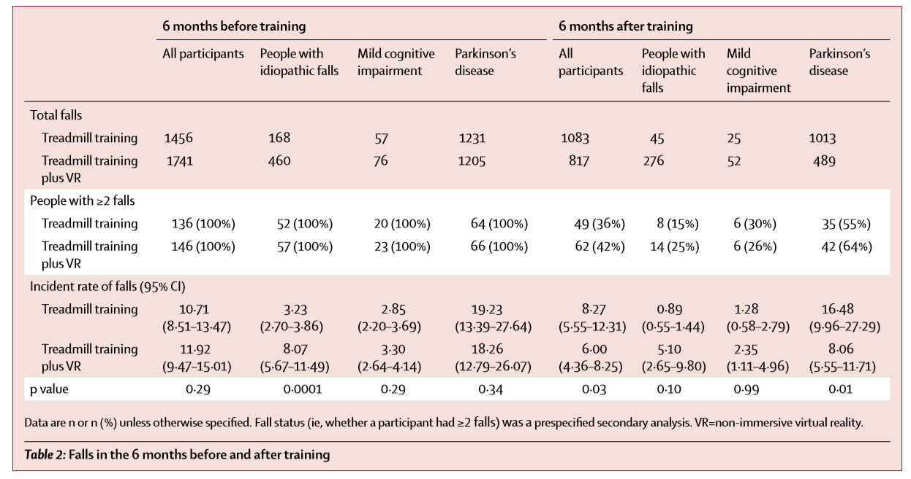

Slide 14
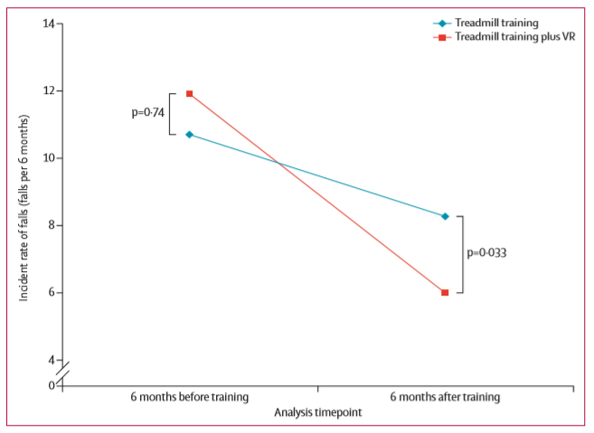

Slide 15
Results
4. Gait speed variability, leading foot clearance, SPPB balance, SPPB gait, and SF-36 improved more in the treadmill training plus VR group than in the treadmill training group.
5. 28 adverse events were reported overall:
(1) 1 death (treadmill training group)
(2) 1 stroke (treadmill training plus VR group)
(3) 1 head injury(treadmill training plus VR group)
(4) 2 myocardial infarctions (心肌梗塞) (treadmill training group)
(5) Exacerbated orthopaedic-related pain or arthritis (关节炎) (4 vs 5)
(6) Herpes zoster (带状疱疹) (1 vs 0)
(7) Rhabdomyolysis (横纹肌溶解) (0 vs 1)
(8) Pneumonia (肺炎) (1 vs 1)

Slide 16
Results
5. 28 adverse events were reported overall:
(9) 8 participants sustained a fall during the training period (5 vs 3).
(10) The frequency of these events was similar between the training arms.
6. 171 (61%) of 282 participants reported no falls or only one fall and were therefore no longer classed as having multiple falls.
7. 130 participants with Parkinson’s disease, 77 (59%) were defined as having had multiple falls after training, a significantly smaller proportion than before training.

Slide 17
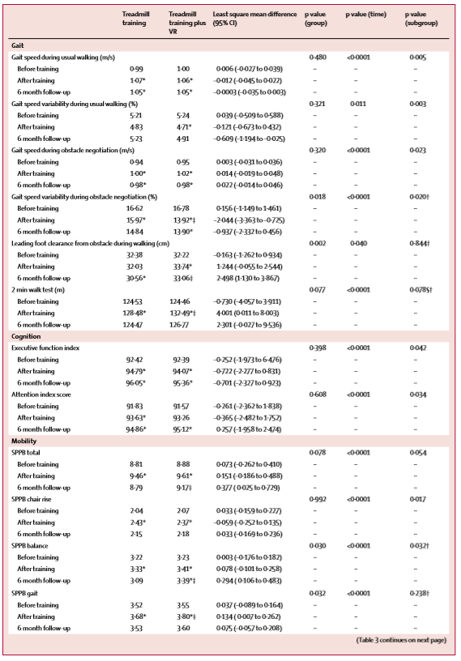

Slide 18
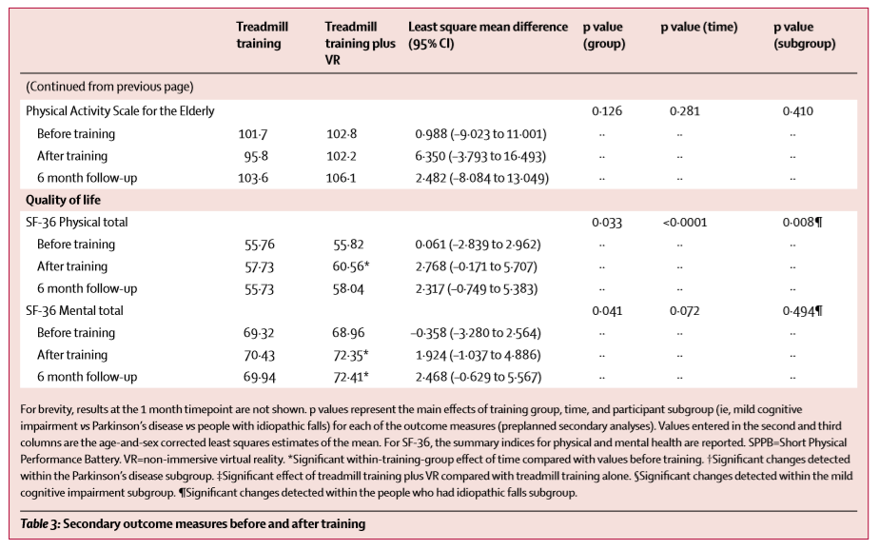

Slide 19
Discussion
1. This study is the first to investigate the effects of an intensive treadmill-based intervention with and without a VR component on fall rates in an older adult population with a high risk of falls.
2. Both treadmill training interventions significantly improved markers of fall risk and fall rates were lowered for both interventions.
3. The rate of falls after training was 42% lower in the treadmill training plus VR arm than in the active control group of treadmill training alone.
4. Although the cognitive outcome measures were not sensitive enough to detect diﬀerences between training groups, everyday activities such as obstacle avoidance, which do require cognitive function, improved to a larger extent with the treadmill training plus VR intervention than they did with treadmill training alone.

Slide 20
Discussion
5. Information about falls before training was based on a self-reported estimate for the previous 6 months, which introduces well-known recall bias.

Slide 21
Conclusion
1. Our results suggest that treadmill training plus VR training has an advantage over treadmill training alone, especially in people with Parkinson’s disease.
2. It could be that falls improved particularly in this subgroup (Parkinson) because the pathophysiology (病理生理学) of falls in Parkinson’s disease usually involves the interplay between motor and cognitive deficits.
3. The additional costs of treadmill training plus a VR component (<€4000 for a simple clinical set-up).
4. High retention rate (81%) shows the engagement and adherence (依从性) of the subjects, and the very few adverse events that occurred were deemed to be unrelated to training.

